Slide 1
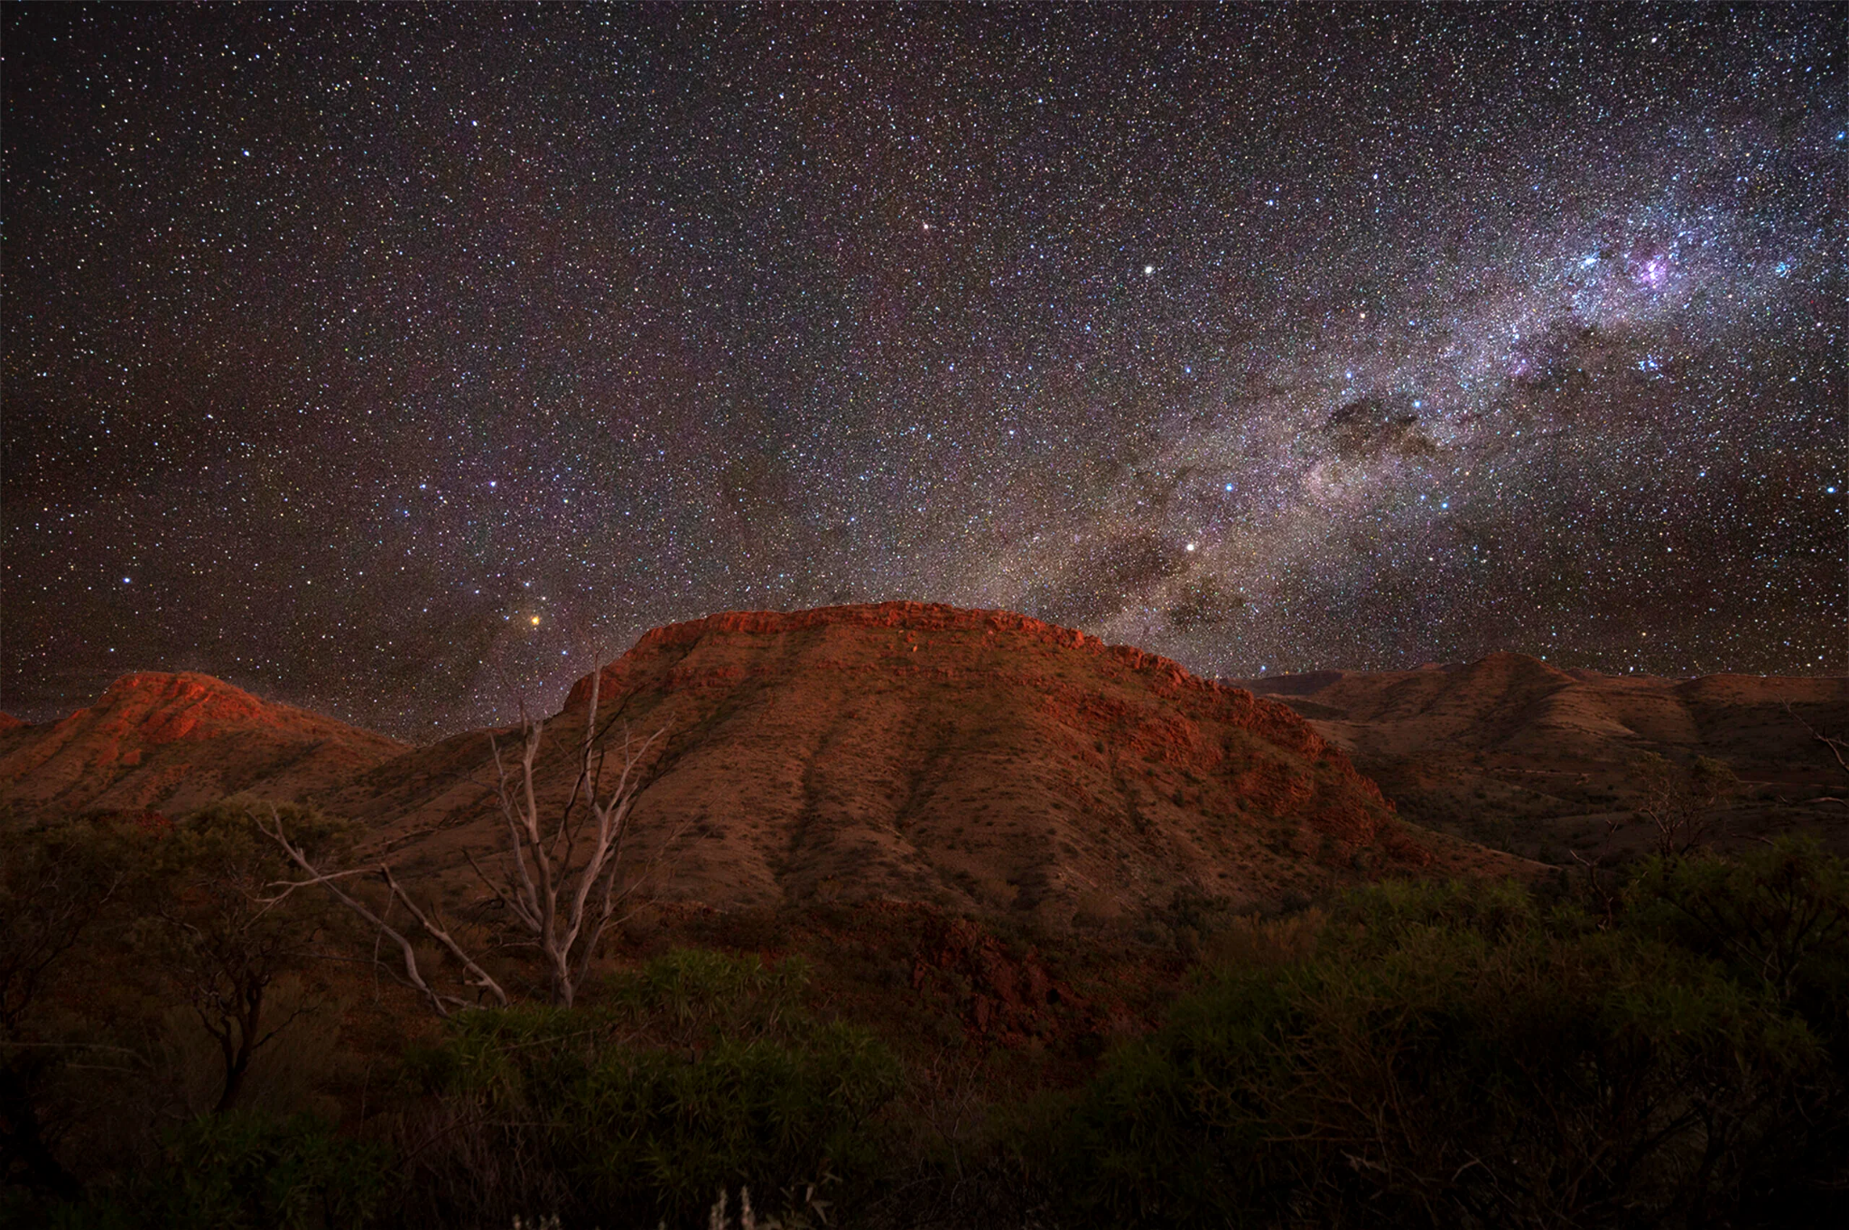
Modelling the Dusty Spiral Nebulae of Binary Wolf-Rayet Stars
Ryan White

Slide 2
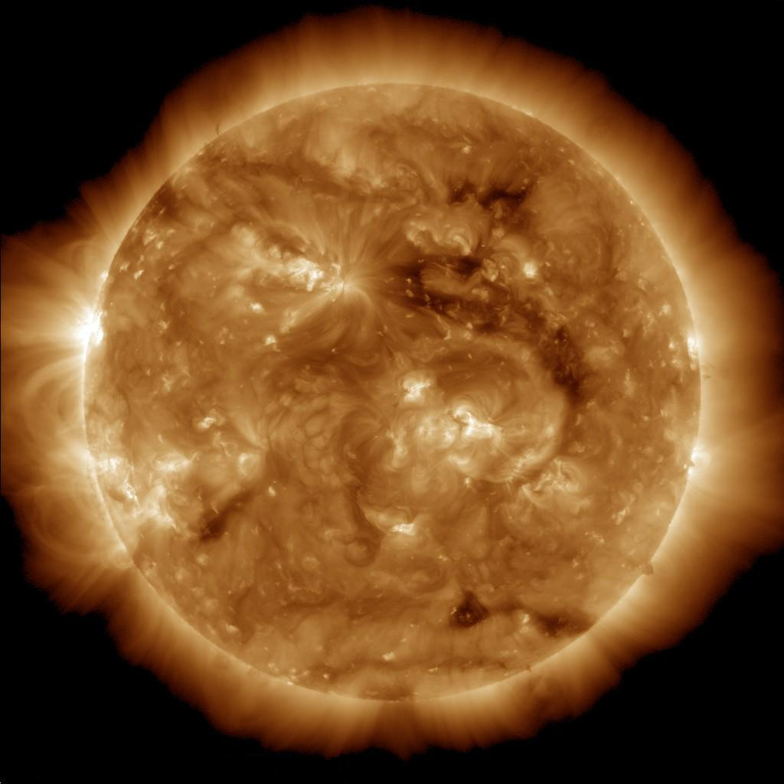
The Sun
Credit: NASA

Slide 3
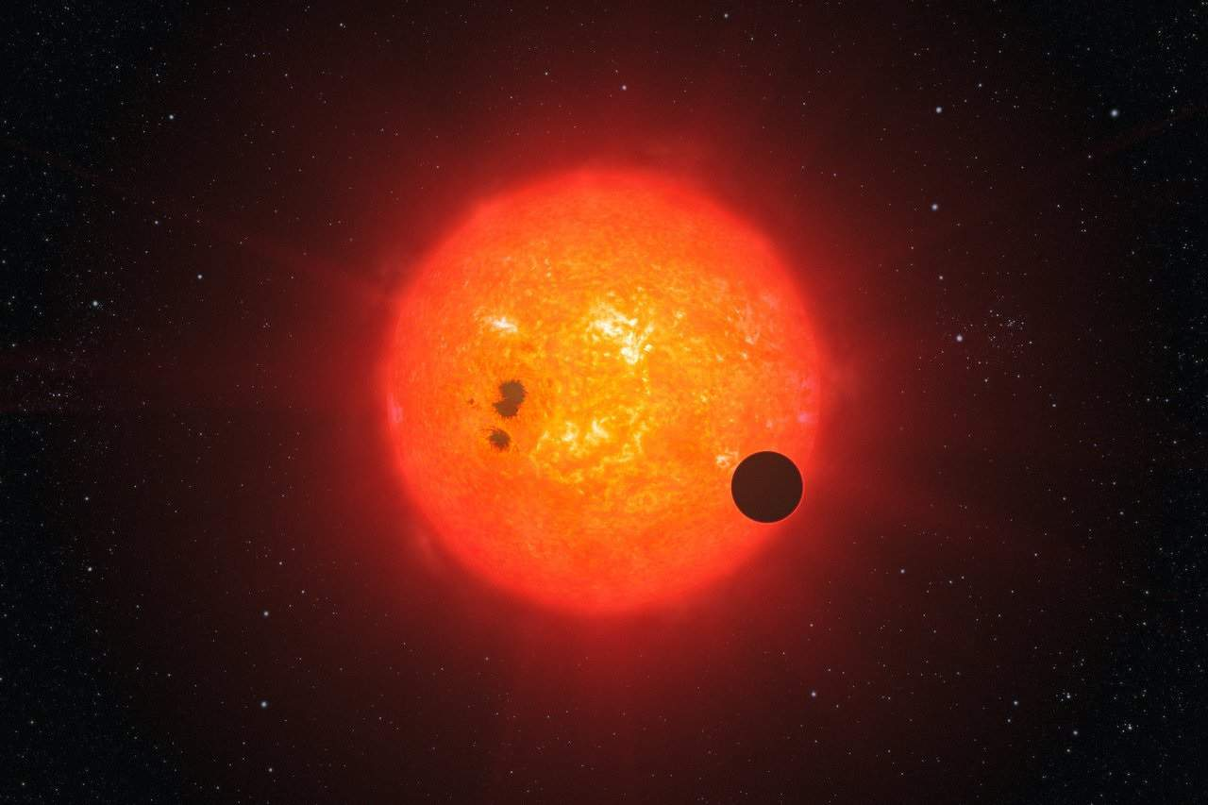
The Sun (in roughly 4 billion years)
Credit: ESO/L Calçada

Slide 4
The Sun
Credit: NASA

Slide 5
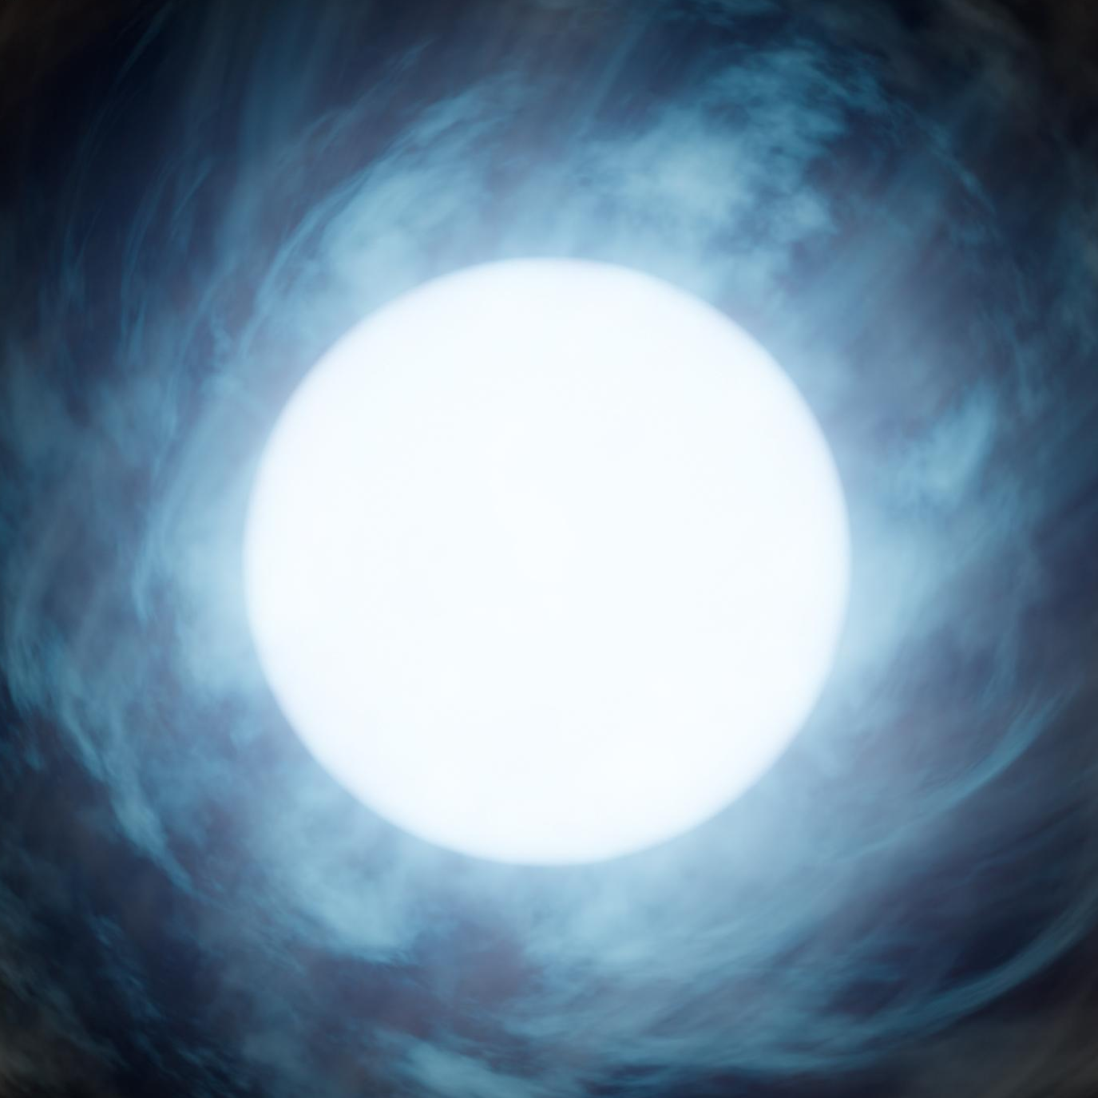
The Sun
Wolf-Rayet Star
Credit: NASA/JPL-Caltech

Slide 6

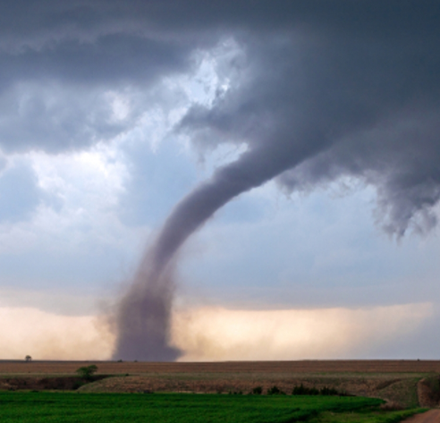
The Sun
Wolf-Rayet Star

Slide 7
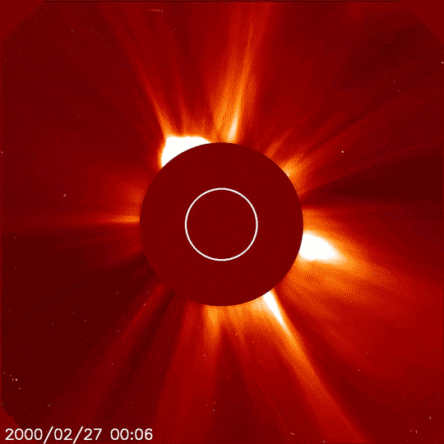
The Sun
Wolf-Rayet Star
Credit: NASA/JPL-Caltech

Slide 8
The Sun
Wolf-Rayet Star
Credit: NASA

Slide 9

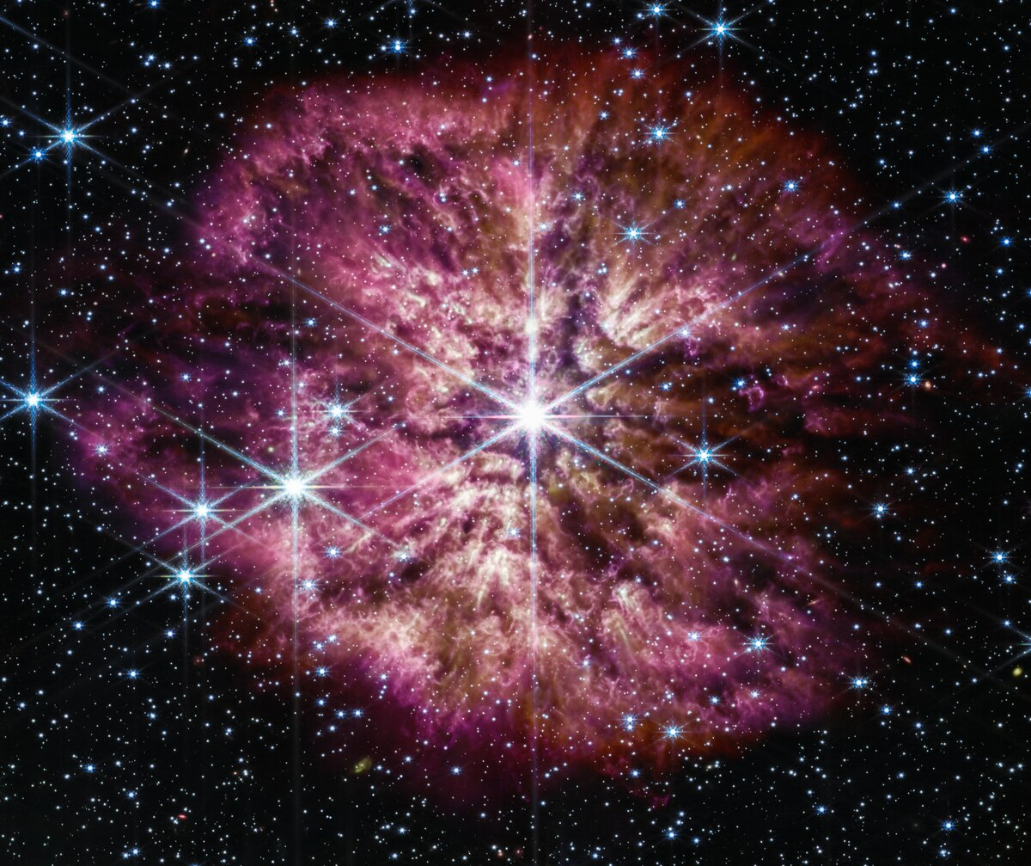
The Sun
Wolf-Rayet Star
(WR124)
Credit: NASA/ESA

Slide 10
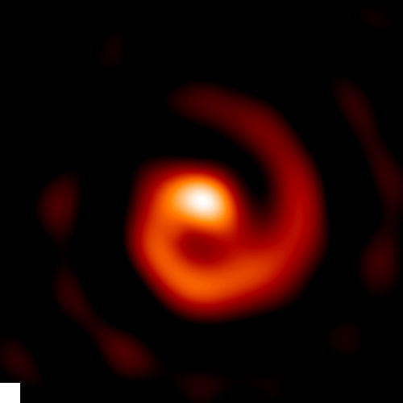
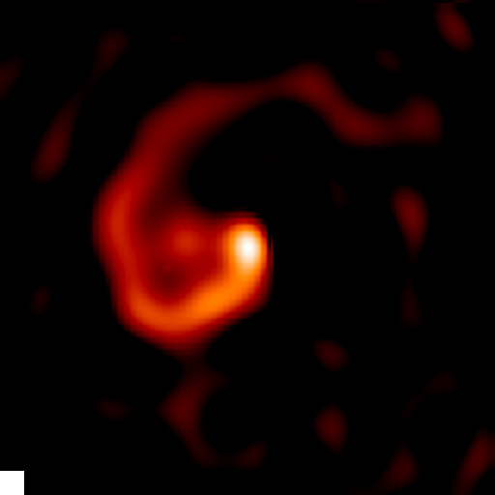
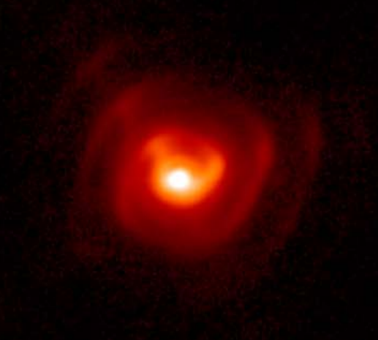
WR104
WR112
WR98a
Credit: Tuthill et al. & Lau et al.

Slide 11
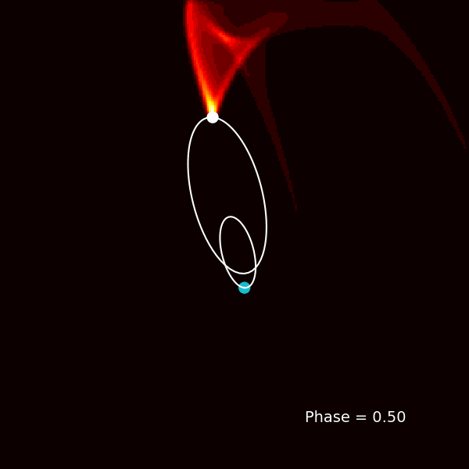

Slide 12
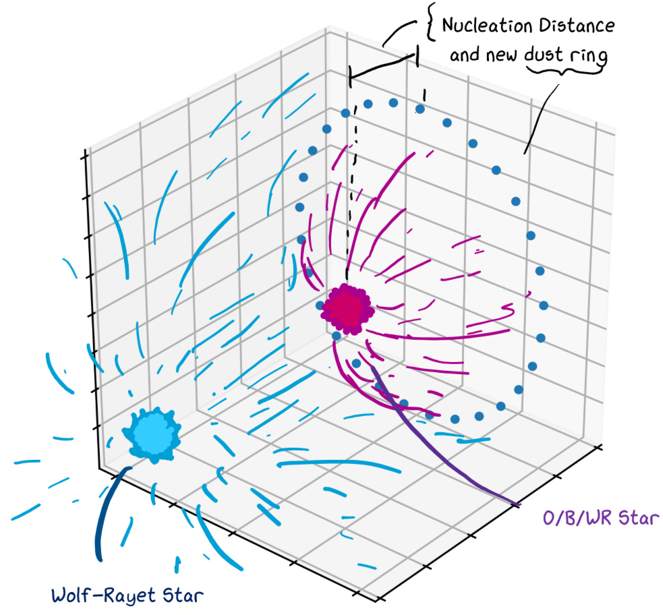

Slide 13
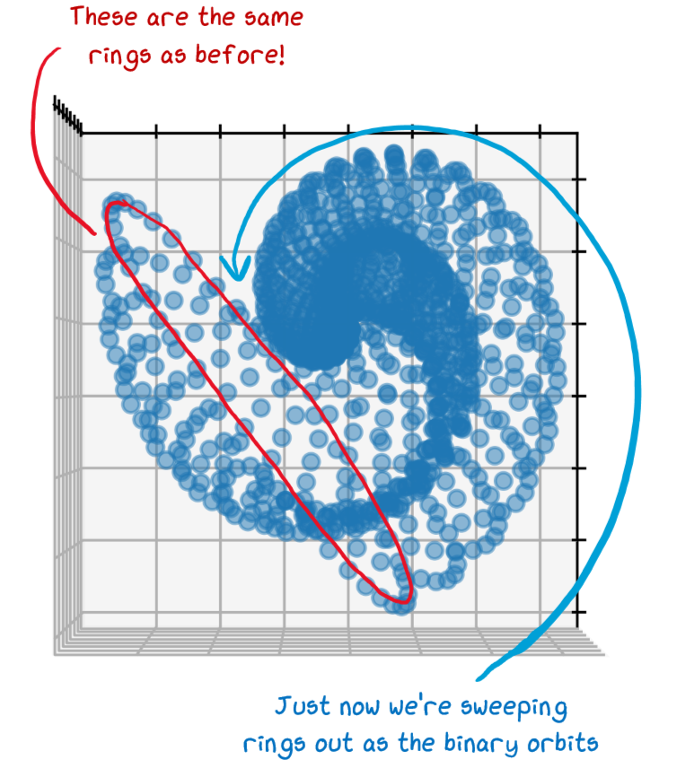

Slide 14
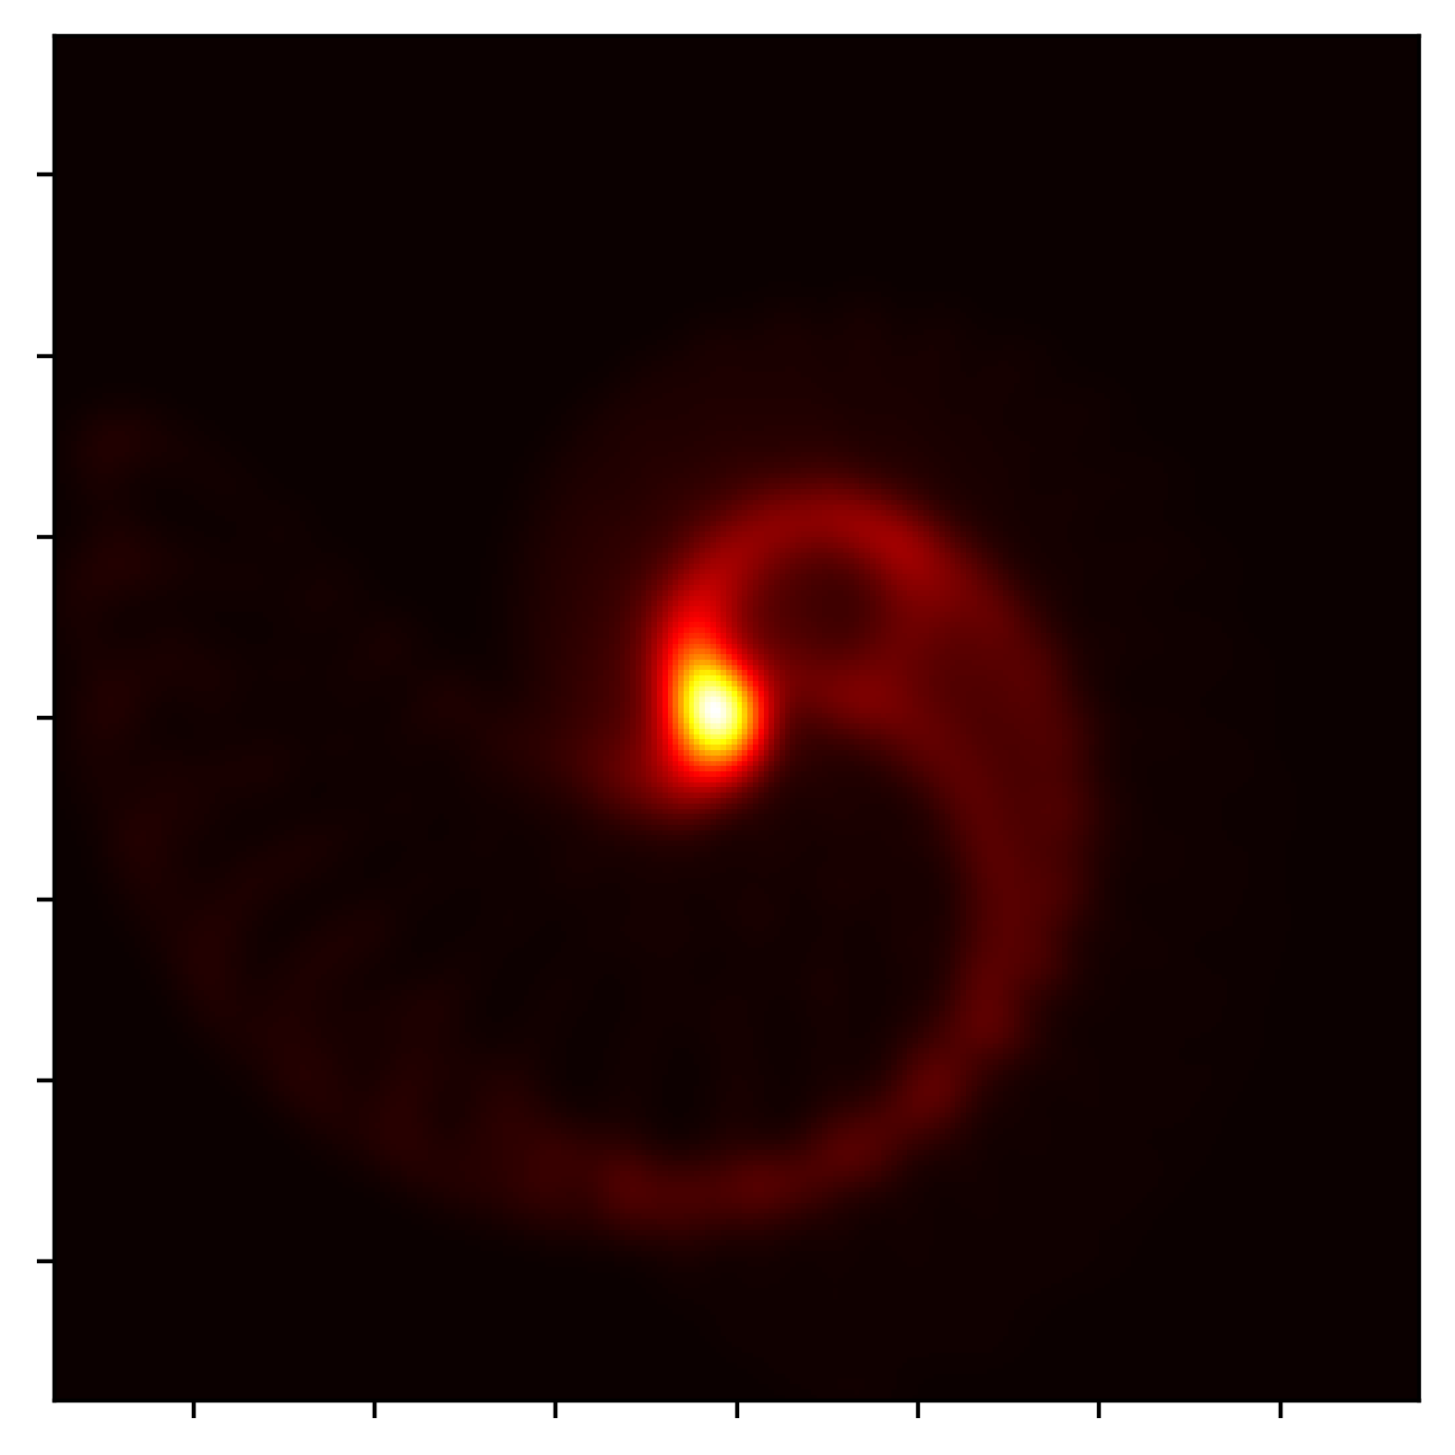

Slide 15
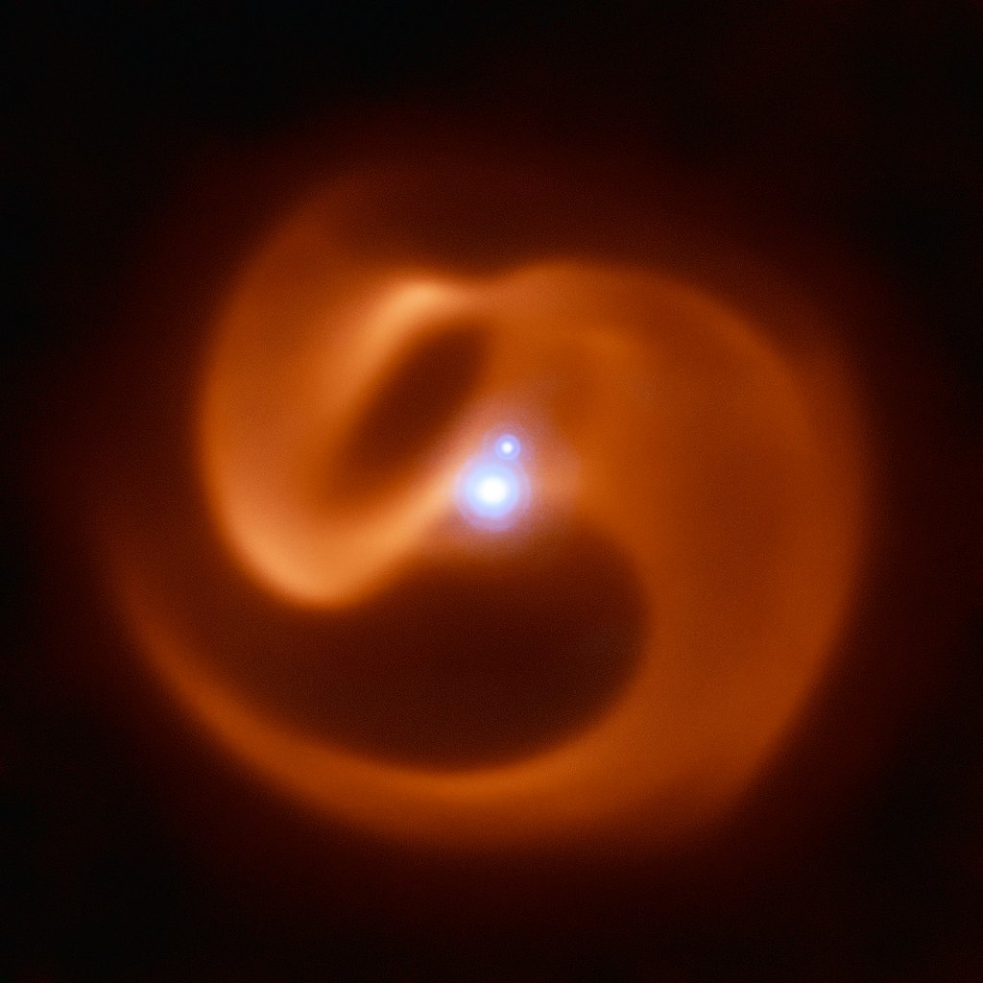
‘Apep’ – the Egyptian god of chaos
Credit: ESO/Callingham et al.

Slide 16
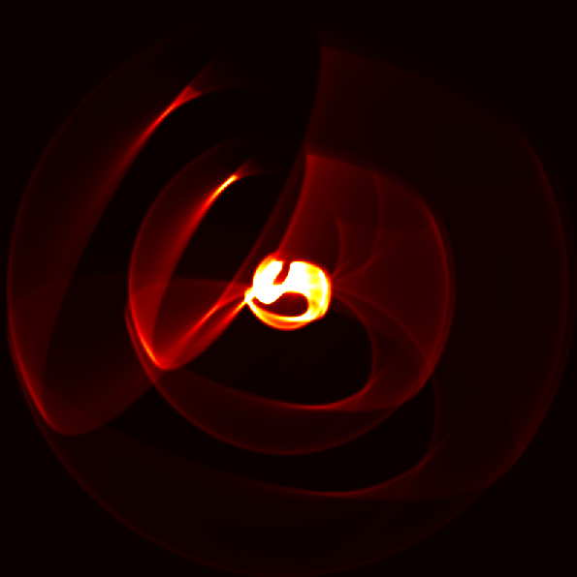
‘Apep’ – the Egyptian god of chaos

Slide 17
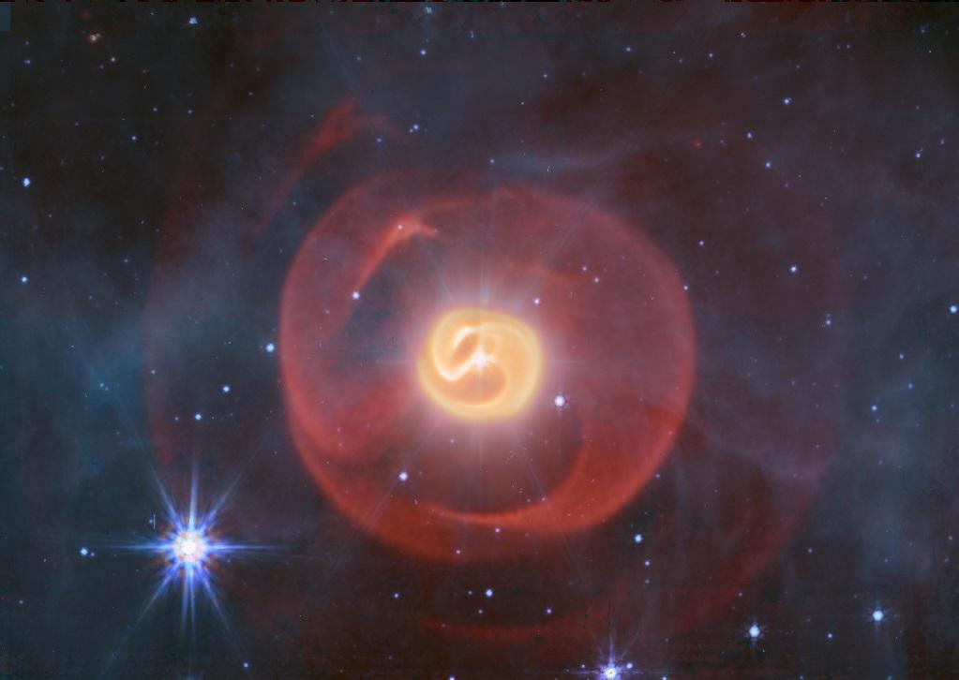
**Image is embargoed! Please do not photograph or share**

Slide 18
Thank you!
Questions?

